Slide 1
Multi-Token Prediction with Consistency Method
Selective Distribution Consistency + Latent Consistency Matching
Reporter：陳九龍

Slide 2
CONTENTS
01
04
Introduction
Experiment results
Page 4 ~ Page 7
Page 16 ~ Page 23
05
02
Related works
Conclusion
Page 9 ~ Page 10
Page 25 ~ Page 26
03
Proposed method
Page 12 ~ Page 14

Slide 3
Introduction
ONE

Slide 4
Part1: Introduction
Background — Multi-token prediction for faster generation
Multi-token prediction (MTP) (Gloeckle et al., 2024) 的目標：一次 forward 不只預測下一個 token，也讓多個 draft models 預測更遠的 future tokens。
Input: t₀
Model
(target + draft)
self-speculative decoding
Output: t₁… t_{k}
核心假設：若 draft 的預測與主模型一致，self-speculative decoding 就能一次接受多個 token，降低實際推論成本。

Slide 5
Part1: Introduction
Motivation — deeper draft model are harder to optimize
標準 MTP 只用 CE loss 訓練每個 target, draft model，但不同 model 之間缺少明確的一致性約束。
問題
Draft model 預測越遠， 越不準確
Draft model 預測越遠，越難最佳化
研究焦點：在 pretrain 階段中，不改變 MTP model 架構的前提下，僅在 loss 加入 regulation(Consistency Method)，以此提升模型表現。

Slide 6
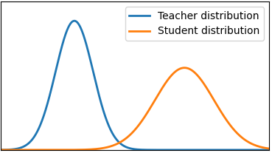
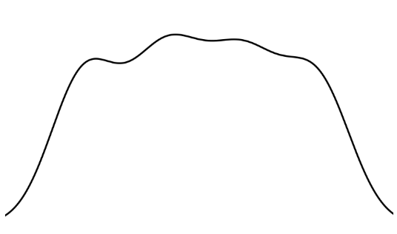
Part1: Introduction
Research method
在本實驗中所使用的Consistency Method 共分為兩種： selective distribution consistency(SDC), latent consistency matching(LCM)
SDC
這是我們新研發的方法，目標是讓 student output probability distribution align teacher output probability distribution
LCM(Samragh et al., 2025)
除了對齊 probability distribution 之外，我們還需要在latent(embedding) layer，讓 student 更靠近 teacher。
下圖所示為多維壓縮成二維的展示
shift
get close
並且，算法會把teacher低信心度(下圖所示)的 token mask 掉，在計算SDC 會忽略這個位置的 token

Slide 7
Part1: Introduction
Contributions
01
Selective Distribution Consistency
在pretrain階段，我們提出SDC來當作loss的regulation term，以此約束draft model，讓其的預測結果更符合teacher model所期待的。
02
Experimental Result
我們提供實驗結果包括Oracle PPL、Average draft token accepted、Generative PPL…，當作比起baseline改善證據，其中Generative PPL提升約52%，改善幅度最大
03
SDC + LCM joint training
從實驗結果來看能發現，SDC 與 LCM 並不會互相衝突造成反效果。

Slide 8
Related works / MTP

Slide 9
Part2: Related works / MTP
Multi-Token Prediction architecture
2
3
4
5
outputs:
3
4
5
6
4
5
5
6
6
7
7
8
Head 1
2
3
4
Shared
Inputs:
1
2
3
4
Head 1 對應標準 next-token prediction (target model)。
Head 2~K 對應 draft model。
模型架構重點：計算成本主要集中在 shared trunk；多個 heads 的額外成本相對較小，因此可用於 draft token prediction。

Slide 10
Part2: Related works / MTP
Baseline training
未加入 consistency 時，每個 head 只根據自己的 target offset 計算 CE loss。
Forward
Backward
CE Loss 1
CE Loss 2
… …
CE Loss K
z = model.shared(x)
d = z.detach()
d.requires_grad = True
for i in range(n):
p = model.head[i](d)
loss(p, y[i]).backward()
z.backward(gradient=d.grad)
Head 1
Head 2
… …
Head K
Shared
優點：架構簡單，與標準 LM 訓練流程相容。
限制：Head 2~K 的 distribution 可能與可靠 teacher / Head 1 不一致。

Slide 11
Proposed method
THREE

Slide 12
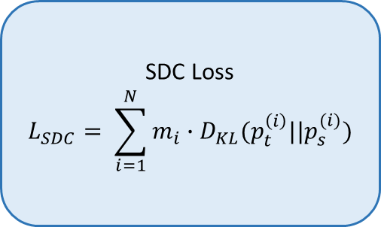
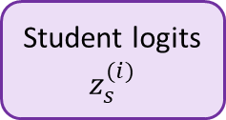
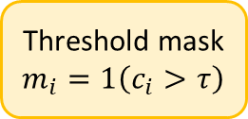
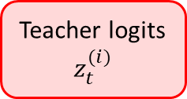
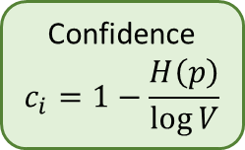
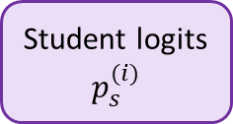
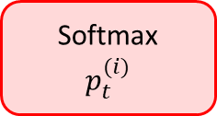
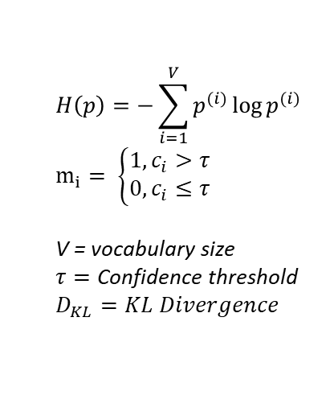
Part3: Proposed method
Selective Distribution Consistency
Teacher logits
$$z_{t}^{(i)}$$
Softmax
$$p_{t}^{(i)}$$
Confidence
$$c_{i}=1−\frac{H\left(p\right)}{\log{V}}$$
Threshold mask
$$m_{i}=1\left(c_{i}>τ\right)$$
SDC Loss
$$L_{SDC}= \sum_{i=1}^{N}{m_{i}∙D_{KL}(p_{t}^{\left(i\right)}||p_{s}^{(i)})}$$
Student logits
$$z_{s}^{(i)}$$
Student logits
$$p_{s}^{(i)}$$
$$H\left(p\right)=−\sum_{i=1}^{V}{p^{(i)}}\log{p^{(i)}}$$
$$m_{i}= \left\{\begin{aligned}1,c_{i}>τ \\ 0,c_{i}≤τ\end{aligned}\right.$$
V = vocabulary size
$$τ=\text{Confidence} \text{threshold}$$
$$D_{KL}=KL Divergence$$
t = softmax(model.head[0](d).detach())
c = confidence(t)
for i in range(1,n):
s = softmax(model.head[i](d))
sdc_loss = 0
for j in range(c.length):
if c[j] >= threshold:
sdc_loss += kl(t[j], s[j])
total_loss += sdc_loss
confidence threshold τ 控制噪聲遮罩。
若 τ 過高，會讓模型整體傾向高信心度/重複度的回答，可能造成 PPL / draft acceptance 下降，GenPPL/ repetition上升。

Slide 13
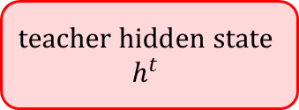
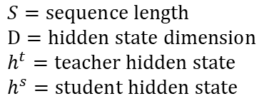
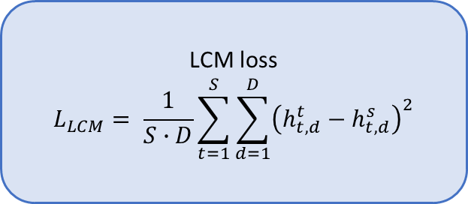
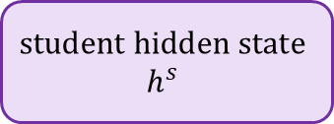
Part3: Proposed method
Latent Consistency Matching
LCM 不直接對齊 softmax probability distribution，而是在 latent / hidden representation 層級對齊 teacher 與 student。
$$\text{teacher} \text{hidden} \text{state}$$
$$h^{t}$$
LCM loss
$$L_{LCM}= \frac{1}{S∙D}\sum_{t=1}^{S}{\sum_{d=1}^{D}{{\left(h_{t,d}^{t}−h_{t,d}^{s}\right)}^{2}}}$$
$$\text{student} \text{hidden} \text{state}$$
$$h^{s}$$
h_t = model.head[0](d).last_hidden_state.detach()
c = confidence(t)
for i in range(1,n):
h_s = model.head[i](d).last_hidden_state
lcm_loss = (h_t - h_s).pow(2).mean().mean()
total_loss += lcm _loss
$$S=\text{sequence} \text{length}$$
$$D=\text{hidden} \text{state} \text{dimension}$$
$h^{t}=\text{teacher} \text{hidden} \text{state}$
$$h^{s}=\text{student} \text{hidden} \text{state}$$

Slide 14

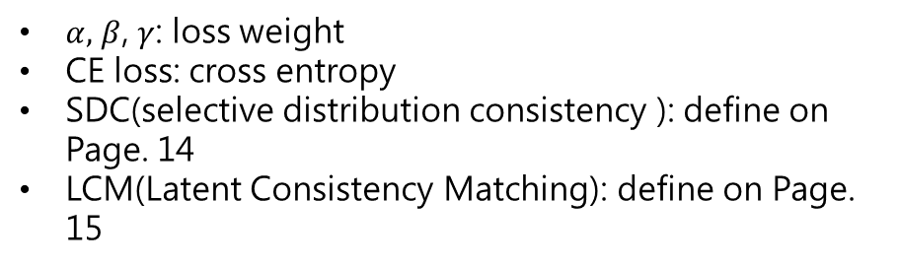
Part3: Proposed method
Method overview
本研究將 MTP CE loss 與 SDC / LCM consistency loss 結合，對齊 teacher和student 在probability與latent的分佈。
… …
Forward
Backward
Teacher probability or latent
Student latent
Student probability
Add
Add
CE Loss 1
CE Loss 2
LCM Loss 2
SDC Loss K
… …
CE Loss K
LCM Loss K
SDC Loss K
Head 1
Head 2
… …
Head K
$$L_{total}={α∙L}_{CE}+{β∙L}_{SDC}+{γ∙L}_{LCM}$$
$α,$ $β$, $γ$: loss weight
CE loss: cross entropy
SDC(selective distribution consistency ): define on Page. 14
LCM(Latent Consistency Matching): define on Page. 15
Shared

Slide 15
Experiment results
FOUR

Slide 16
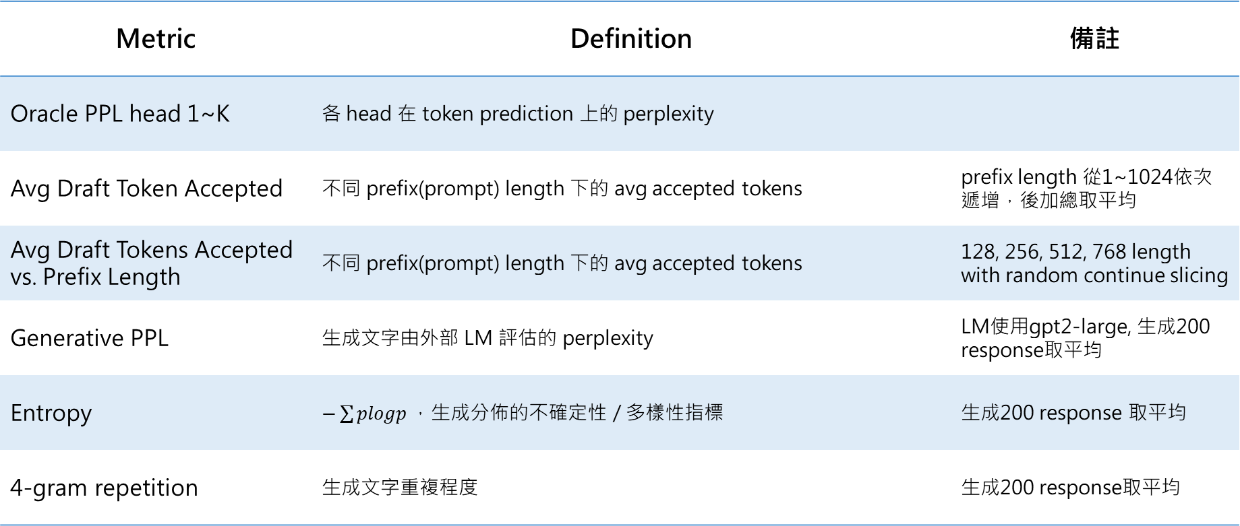
Part4: Experiment results
Evaluation metrics
Metric | Definition | 備註
Oracle PPL head 1~K | 各 head 在 token prediction 上的 perplexity
Avg Draft Token Accepted | 不同 prefix(prompt) length 下的 avg accepted tokens | prefix length 從1~1024依次遞增，後加總取平均
Avg Draft Tokens Accepted vs. Prefix Length | 不同 prefix(prompt) length 下的 avg accepted tokens | 128, 256, 512, 768 length with random continue slicing
Generative PPL | 生成文字由外部 LM 評估的 perplexity | LM使用gpt2-large, 生成200 response取平均
Entropy | $−\sum{plogp}，$生成分佈的不確定性 / 多樣性指標 | 生成200 response 取平均
4-gram repetition | 生成文字重複程度 | 生成200 response取平均

Slide 17
Part4: Experiment results
Formal 1.3B comparison — SDC+LCM vs. baseline. Oracle PPL
10B token for training model
Metric | SDC+LCM | baseline | Improvement
PPL head 1 | 19.1695 | 19.4293 | 1.34%
PPL head 2 | 83.7266 | 87.2351 | 4.02%
PPL head 3 | 189.2825 | 200.0813 | 5.40%
PPL head 4 | 299.5625 | 318.3247 | 5.89%
Observation
Head 預測越遠的token時，perplexity 顯著降低達到5.89%，符合假設。
特別注意 Head 1 也有些許提升

Slide 18
Part4: Experiment results
Formal 1.3B comparison — SDC+LCM vs. baseline. Avg Draft Tokens Accepted
10B token for training model
Metric | SDC+LCM | baseline | Improvement
Avg Draft Tokens Accepted | 0.7302 ± 0.0000 | 0.7010 ± 0.0000 | 4.17%
Prefix 128 | 0.9653 ± 0.0401 | 0.9117 ± 0.0205 | 5.88%
Prefix 256 | 0.9873 ± 0.0063 | 0.9458 ± 0.0068 | 4.39%
Prefix 512 | 1.0158 ± 0.0309 | 0.9689 ± 0.0221 | 4.84%
Prefix 768 | 1.0272 ± 0.0250 | 0.9760 ± 0.0222 | 5.25%
Observation
Avg Draft Tokens Accepted提升4.17%
在Prefix length 768，Draft Tokens Accepted顯著提升
Note
Greedy self-speculative decoding for sampling
每次只生成一個token就結束

Slide 19
Part4: Experiment results
Formal 1.3B comparison — SDC+LCM vs. baseline. Generative quality
10B token for training model
Metric | SDC+LCM | baseline | Improvement
Generative PPL | 18.7180 ± 0.8276 | 39.5580 ± 0.9425 | 52.68%
Entropy | 6.8620 ± 0.0202 | 7.3223 ± 0.0351 | 6.29%
4-gram repetition | 0.0526 ± 0.0147 | 0.0229 ± 0.0084 | -130.17%
Observation
Generative PPL 提升52.68%
4-gram repetition雖然下降130.17%，但是實際數值只差約0.03
Note
Top-p and temperature for sampling
生成直到max sequence length 或 eos

Slide 20
Part4: Experiment results
Formal 1.3B comparison — SDC+LCM vs. baseline. Zero-shot PPL improvement by head
10B token for training model
Dataset | Head 1 | Head 2 | Head 3 | Head 4 | Observation
Wikitext | 0.32% | 7.57% | 7.19% | 5.62% | consistency mainly improves distant draft prediction.
PTB | 13.82% | 9.90% | 10.53% | 5.63% | regular syntax leads to gains across all heads.
Lambada | 38.53% | 10.43% | 4.44% | 3.27% | strong context dependence produces the largest Head 1 gain.
Arxiv | 1.48% | 3.94% | 3.71% | 0.27% | domain-specific knowledge limits improvement.
PubMed | 7.04% | 7.76% | 8.33% | 8.26% | structured biomedical writing provides stable gains across heads.
Conclusion
SDC+LCM能提升Head 1(teacher)在有結構性語句的表現
Wikitext與Openwebtext類似，所以只在Head 2~4有提升
縮然有使用SDC + LCM約束Head 2~4，但實際上Head 4相比其他Head在unseen的文本上提升不明顯

Slide 21
Part4: Experiment results
Ablation study — Oracle PPL
1B token for training model
Let S_{W}, τ, and L_{W} denote the SDC term weight, confidence threshold, and LCM term weight, respectively.
Setting | Head 1 PPL | Head 2 PPL | Head 3 PPL | Head 4 PPL
baseline | 26.2356 ± 0.0000 | 121.8033 ± 0.0000 | 269.2450 ± 0.0000 | 406.6959 ± 0.0000
S_{W}=1.0, τ=0.0, L_{W}=0.0 | 26.7541 ± 0.0000 | 120.6687 ± 0.0000 | 261.6664 ± 0.0000 | 394.6503 ± 0.0000
S_{W}=1.0, τ=0.3, L_{W}=0.0 | 26.8150 ± 0.0000 | 120.5276 ± 0.0000 | 261.9479 ± 0.0000 | 394.7055 ± 0.0000
S_{W}=1.0, τ=0.6, L_{W}=0.0 | 27.7396 ± 0.0000 | 129.2922 ± 0.0001 | 278.8881 ± 0.0000 | 417.5874 ± 0.0000
S_{W}=1.5, τ=0.3, L_{W}=0.0 | 27.2684 ± 0.0000 | 122.5244 ± 0.0000 | 264.6119 ± 0.0000 | 397.3106 ± 0.0000
S_{W}=0.5, τ=0.3, L_{W}=0.0 | 26.4587 ± 0.0000 | 120.7186 ± 0.0000 | 265.0660 ± 0.0000 | 402.0413 ± 0.0000
S_{W}=0.0, τ=0.0, L_{W}=0.5 | 25.7096 ± 0.0000 | 118.9247 ± 0.0000 | 262.1637 ± 0.0000 | 397.9911 ± 0.0000
S_{W}=0.0, τ=0.0, L_{W}=1.0 | 25.5312 ± 0.0000 | 118.5823 ± 0.0000 | 261.1872 ± 0.0000 | 395.1838 ± 0.0000
S_{W}=0.0, τ=0.0, L_{W}=1.5 | 25.4583 ± 0.0000 | 119.1595 ± 0.0000 | 263.2083 ± 0.0000 | 398.8679 ± 0.0000
S_{W}=1.0, τ=0.3, L_{W}=0.5 | 26.2402 ± 0.0000 | 118.2168 ± 0.0000 | 257.0344 ± 0.0000 | 387.7455 ± 0.0000
S_{W}=1.0, τ=0.3, L_{W}=1.0 | 26.4553 ± 0.0000 | 119.2975 ± 0.0000 | 258.4100 ± 0.0000 | 390.7829 ± 0.0000
S_{W}=1.5, τ=0.3, L_{W}=1.0 | 26.5485 ± 0.0000 | 118.4341 ± 0.0000 | 254.9612 ± 0.0000 | 383.7626 ± 0.0000
Observation
SDC weight上升
Head 1 PPL 上升
Head 2~4較不受影響
LCM weight上升
Head 1 PPL 下降
Head 2~4較不受影響
Confidence Threshold上升
All Head PPL 上升
Conclusion
SDC + LCM會使除了Head 1外的PPL下降。
至於Head 1 PPL上升，推測是訓練資料不夠

Slide 22
Part4: Experiment results
Ablation study — Avg Draft Tokens Accepted
1B token for training model
Let S_{W}, τ, and L_{W} denote the SDC term weight, confidence threshold, and LCM term weight, respectively.
Setting | Avg Draft Token Accepted | Prefix 128 | Prefix 256 | Prefix 512 | Prefix 768
baseline | 0.6238 ± 0.0000 | 0.8251 ± 0.0140 | 0.8205 ± 0.0062 | 0.8519 ± 0.0195 | 0.8552 ± 0.0233
S_{W}=1.0, τ=0.0, L_{W}=0.0 | 0.6388 ± 0.0000 | 0.8374 ± 0.0165 | 0.8746 ± 0.0108 | 0.8736 ± 0.0158 | 0.8802 ± 0.0029
S_{W}=1.0, τ=0.3, L_{W}=0.0 | 0.6400 ± 0.0000 | 0.8406 ± 0.0131 | 0.8602 ± 0.0232 | 0.8720 ± 0.0233 | 0.8772 ± 0.0015
S_{W}=1.0, τ=0.6, L_{W}=0.0 | 0.6113 ± 0.0000 | 0.7908 ± 0.0074 | 0.7919 ± 0.0086 | 0.8009 ± 0.0035 | 0.8174 ± 0.0130
S_{W}=1.5, τ=0.3, L_{W}=0.0 | 0.6414 ± 0.0000 | 0.8522 ± 0.0098 | 0.8581 ± 0.0139 | 0.8897 ± 0.0043 | 0.9082 ± 0.0204
S_{W}=0.5, τ=0.3, L_{W}=0.0 | 0.6345 ± 0.0000 | 0.8195 ± 0.0122 | 0.8416 ± 0.0115 | 0.8601 ± 0.0065 | 0.8644 ± 0.0304
S_{W}=0.0, τ=0.0, L_{W}=0.5 | 0.6398 ± 0.0000 | 0.8517 ± 0.0156 | 0.8589 ± 0.0096 | 0.8794 ± 0.0050 | 0.8895 ± 0.0257
S_{W}=0.0, τ=0.0, L_{W}=1.0 | 0.6442 ± 0.0000 | 0.8491 ± 0.0130 | 0.8698 ± 0.0154 | 0.8919 ± 0.0168 | 0.8943 ± 0.0012
S_{W}=0.0, τ=0.0, L_{W}=1.5 | 0.6467 ± 0.0000 | 0.8510 ± 0.0112 | 0.8862 ± 0.0054 | 0.8951 ± 0.0129 | 0.9028 ± 0.0327
S_{W}=1.0, τ=0.3, L_{W}=0.5 | 0.6507 ± 0.0000 | 0.8498 ± 0.0339 | 0.8615 ± 0.0179 | 0.8987 ± 0.0103 | 0.8862 ± 0.0151
S_{W}=1.0, τ=0.3, L_{W}=1.0 | 0.6495 ± 0.0000 | 0.8402 ± 0.0209 | 0.8612 ± 0.0043 | 0.8879 ± 0.0157 | 0.8950 ± 0.0071
S_{W}=1.5, τ=0.3, L_{W}=1.0 | 0.6525 ± 0.0000 | 0.8590 ± 0.0101 | 0.8656 ± 0.0214 | 0.9023 ± 0.0277 | 0.9044 ± 0.0140
Observation
SDC, LCM weight上升都能提升表現
Confidence Threshold上升到特定值，表現下降
跟ppl一樣SDC + LCM會最大程度提升

Slide 23
Part4: Experiment results
Ablation study — Generative quality
1B token for training model
Let S_{W}, τ, and L_{W} denote the SDC term weight, confidence threshold, and LCM term weight, respectively.
Setting | Generative PPL | Entropy | 4-gram repetition
baseline | 83.8285 ± 5.1409 | 7.4068 ± 0.0461 | 0.0119 ± 0.0097
S_{W}=1.0, τ=0.0, L_{W}=0.0 | 68.0596 ± 4.5760 | 7.3141 ± 0.0519 | 0.0193 ± 0.0154
S_{W}=1.0, τ=0.3, L_{W}=0.0 | 26.3414 ± 0.3656 | 6.7567 ± 0.0016 | 0.0460 ± 0.0160
S_{W}=1.0, τ=0.6, L_{W}=0.0 | 28.2332 ± 1.2754 | 6.7789 ± 0.0178 | 0.0393 ± 0.0080
S_{W}=1.5, τ=0.3, L_{W}=0.0 | 31.8082 ± 0.4503 | 6.8248 ± 0.0353 | 0.0485 ± 0.0159
S_{W}=0.5, τ=0.3, L_{W}=0.0 | 52.7654 ± 2.2732 | 7.1490 ± 0.0335 | 0.0323 ± 0.0169
S_{W}=0.0, τ=0.0, L_{W}=0.5 | 26.2091 ± 1.5675 | 6.8576 ± 0.0374 | 0.0555 ± 0.0204
S_{W}=0.0, τ=0.0, L_{W}=1.0 | 24.0955 ± 3.2440 | 6.7935 ± 0.0828 | 0.0657 ± 0.0388
S_{W}=0.0, τ=0.0, L_{W}=1.5 | 29.9033 ± 0.5373 | 6.8644 ± 0.0249 | 0.0215 ± 0.0049
S_{W}=1.0, τ=0.3, L_{W}=0.5 | 21.4788 ± 0.0773 | 6.6876 ± 0.0421 | 0.0720 ± 0.0062
S_{W}=1.0, τ=0.3, L_{W}=1.0 | 26.3414 ± 0.3656 | 6.7567 ± 0.0016 | 0.0460 ± 0.0160
S_{W}=1.5, τ=0.3, L_{W}=1.0 | 25.7832 ± 1.6338 | 6.7177 ± 0.0455 | 0.0453 ± 0.0197
Observation
只要使用到Consistency Method，Entropy會下降， 4-gram repetition會上升
所有參數都有一個最佳值

Slide 24
Conclusion
FIVE

Slide 25
Part5: Conclusion
Conclusion
本研究在 MTP 架構中加入 SDC 與 LCM，不改變架構即能改善 draft head 品質。
正式 1.3B model 比較中，SDC+LCM 使 Head 1~4 PPL 全部下降，且 Head 4 降幅達 5.89%。
token accept rate 從 0.7010 提升到 0.7302，代表 self-speculative decoding 有更好的接受潛力。
Generative PPL 從 39.5580 大幅降至 18.7180，顯示生成品質改善最明顯。
核心訊息：consistency-based training 能有效降低 draft heads 的分佈漂移，使 semi-autoregressive generation 更穩定。

Slide 26
Part5: Conclusion
Future work & references
進一步測試不同模型規模、更多資料量、不同種類資料集。
繼續下一步訓練計畫如Continue training、SFT
訓練足夠多資料量後補上 greedy self-speculative decoding，測試實際 speed-up 與 oracle speed test 對照。

